Slide 1
Salt Hydrolysis Mr. K. K. Ahmed Department of Chemistry Haflong Govt. College, Haflong.

Slide 2
Definition
Salt hydrolysis may be defined as the process in which a salt reacts with water to give back the acid and the base.
Salt + water → Acid +Base
Or, BA + H₂O → HA + BOH
Salt Water Acid Base

Slide 3
All salts are electrolytes and thus ionize completely in aqueous solution. If the acid (HA) produced is strong and the base (BOH) produced is weak, we can write the above equation as –
B⁺ + A⁻ + H₂O → H⁺ + A⁻ + BOH
Or, B⁺ + H₂O → H⁺ + BOH
Thus in this case the cation reacts with water to give an acidic solution. This is called cationic hydrolysis.

Slide 4
Again, if the acid produced is weak and the base produced is strong, we can write –
B⁺ + A⁻ + H₂O → HA + B⁺ + OH⁻
Or, A⁻ + H₂O → HA + OH⁻
Here, the anion reacts with water to give the basic solution. This is called anionic hydrolysis.

Slide 5
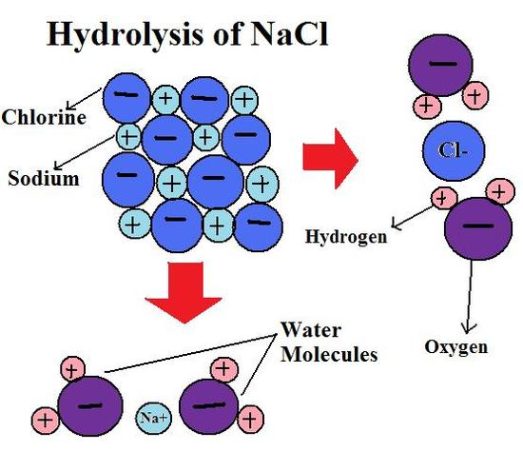
Hence, salt hydrolysis may be defined as the reaction of the cation or the anion of the salt with water to produce acidic or basic solution.

Slide 6
Thank You

